Slide 1

ICED LAVENDER CREAM MATCHA
TOASTED COCONUT CREAM COLD BREW
ICED UBE COCONUT MACCHIATO
ICED LAVENDER LATTE
ICED LAVENDER CREAM CHAI
TOASTED COCONUT LATTE
LAVENDER CREAM FRAPPUCCINO
FROG CAKE POP
SPRING MENU 2026

Slide 2
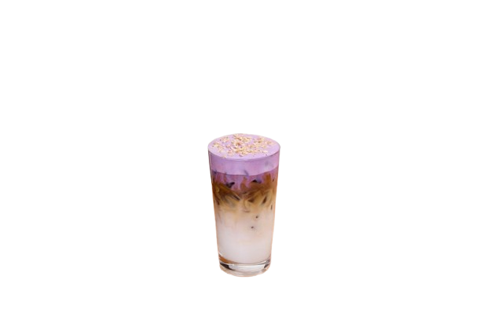
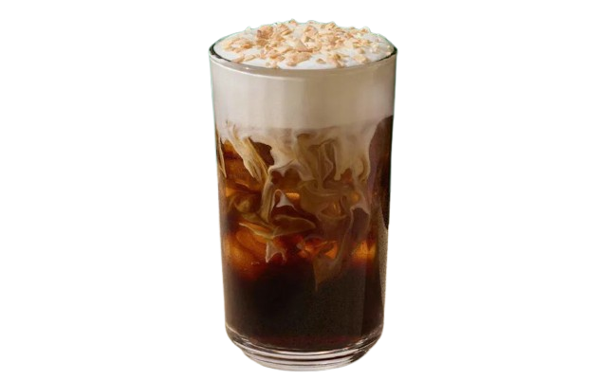
SPRING MENU 2026
ICED UBE COCONUT MACCHIATO
TOASTED COCONUT CREAM COLD BREW
ICED LAVENDER LATTE
ICED LAVENDER CREAM MATCHA
ICED LAVENDER CREAM CHAI
LAVENDER CREAM FRAPPUCCINO
TOASTED COCONUT LATTE
FROG CAKE POP

Slide 3
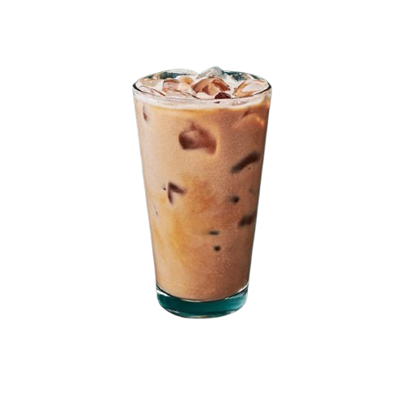
SPRING MENU
- The Starbucks Iced Ube Coconut Macchiato is a spring 2026 beverage featuring espresso, milk, and toasted coconut syrup, topped with a distinctive ube cold foam and coconut flakes.
ICED UBE COCONUT MACCHIATO
TOASTED COCONUT CREAM COLD BREW
ICED LAVENDER LATTE

Slide 4
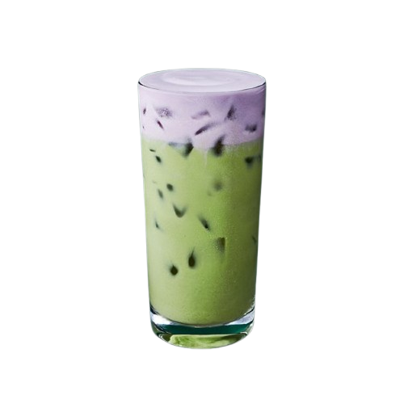
SPRING MENU
- The Starbucks Toasted Coconut Cream Cold Brew is a spring 2026 menu item featuring Starbucks Cold Brew sweetened with vanilla syrup, topped with a toasted coconut cream cold foam, and finished with toasted coconut flakes. It offers a creamy, lightly coconut-forward taste rather than an overpowering tropical flavour.
ICED UBE COCONUT MACCHIATO
TOASTED COCONUT CREAM COLD BREW
ICED LAVENDER LATTE
ICED LAVENDER CREAM MATCHA

Slide 5
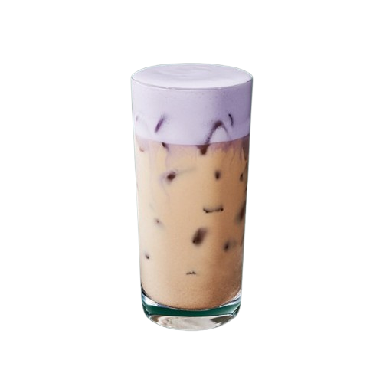
SPRING MENU
- The Iced Lavender Latte is a spring time menu item featuring Blonde Espresso, oat milk, ice, and a proprietary lavender powder. It offers a light, floral, and subtly sweet flavor profile, often described as similar to lavender ice cream with soft vanilla notes.
TOASTED COCONUT CREAM COLD BREW
ICED UBE COCONUT MACCHIATO
ICED LAVENDER LATTE
ICED LAVENDER CREAM MATCHA
ICED LAVENDER CREAM CHAI

Slide 6
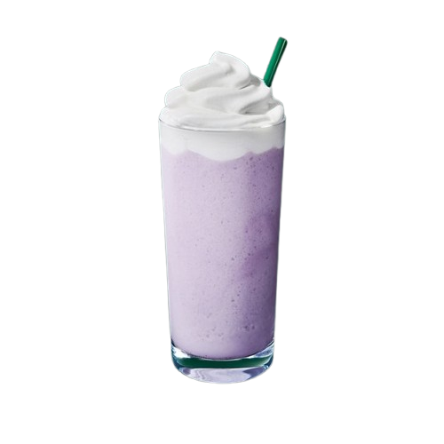
SPRING MENU
- The Starbucks Iced Lavender Cream Matcha is a floral, creamy spring menu item featuring matcha green tea and oat milk, topped with a sweet, lavender-hued cold foam.
TOASTED COCONUT CREAM COLD BREW
ICED UBE COCONUT MACCHIATO
ICED LAVENDER LATTE
ICED LAVENDER CREAM MATCHA
ICED LAVENDER CREAM CHAI
LAVENDER CREAM FRAPPUCCINO

Slide 7
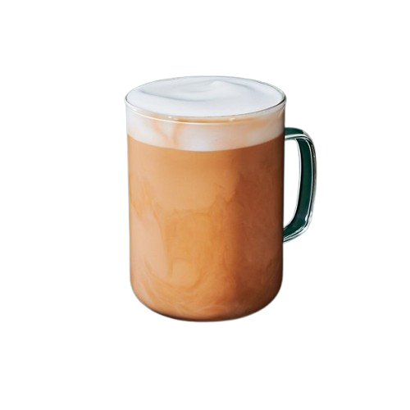
SPRING MENU
- The Starbucks Iced Lavender Cream Chai is a spring 2026 menu addition featuring a classic iced chai tea latte (chai concentrate, milk, ice) topped with a sweet, floral lavender cream cold foam. The drink is known for its light, floral, and creamy profile.
ICED LAVENDER CREAM MATCHA
TOASTED COCONUT CREAM COLD BREW
ICED UBE COCONUT MACCHIATO
ICED LAVENDER LATTE
ICED LAVENDER CREAM CHAI
TOASTED COCONUT LATTE
LAVENDER CREAM FRAPPUCCINO

Slide 8

SPRING MENU
- The Starbucks Lavender Crème Frappuccino is a caffeine-free, blended beverage featuring sweet lavender powder and vanilla syrup mixed with milk and ice, topped with whipped cream.
ICED LAVENDER CREAM MATCHA
ICED LAVENDER CREAM CHAI
TOASTED COCONUT CREAM COLD BREW
ICED UBE COCONUT MACCHIATO
ICED LAVENDER LATTE
LAVENDER CREAM FRAPPUCCINO
TOASTED COCONUT LATTE
FROG CAKE POP

Slide 9
SPRING MENU
- The Starbucks Toasted Coconut Latte is a year-round espresso beverage featuring signature espresso, steamed milk, and a toasted coconut-flavored syrup. It is available hot or iced and offers a sweet, nutty, and creamy flavor.
Something Coming soon…..
ICED LAVENDER CREAM MATCHA
ICED LAVENDER CREAM CHAI
TOASTED COCONUT CREAM COLD BREW
ICED UBE COCONUT MACCHIATO
ICED LAVENDER LATTE
LAVENDER CREAM FRAPPUCCINO
TOASTED COCONUT LATTE
FROG CAKE POP

Slide 10
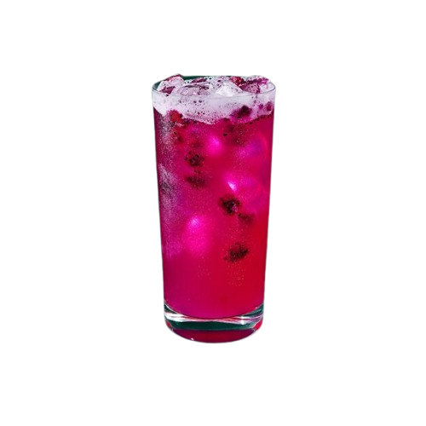
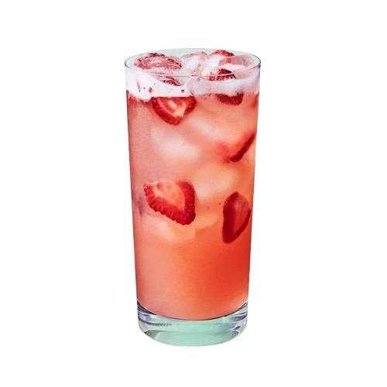
SPRING MENU
- The Starbucks Frog Cake Pop, introduced in spring 2026, is a vegetarian-friendly treat featuring vanilla cake mixed with buttercream, dipped in green chocolaty icing. It has a similar taste to the classic birthday cake pop—soft and dense—and is designed to look like a friendly frog.
ICED LAVENDER CREAM MATCHA
ICED LAVENDER CREAM CHAI
TOASTED COCONUT CREAM COLD BREW
ICED UBE COCONUT MACCHIATO
ICED LAVENDER LATTE
LAVENDER CREAM FRAPPUCCINO
TOASTED COCONUT LATTE
FROG CAKE POP
Something Coming soon…..
CUSTOMIZED REFRESHERS

Slide 11
Coming soon…..
ICED LAVENDER CREAM MATCHA
ICED LAVENDER CREAM CHAI
FROG CAKE POP
TOASTED COCONUT CREAM COLD BREW
ICED UBE COCONUT MACCHIATO
ICED LAVENDER LATTE
LAVENDER CREAM FRAPPUCCINO
TOASTED COCONUT LATTE
CUSTOMIZED REFRESHERS

Slide 12
THANK YOU FOR WATCHING !!!
ICED LAVENDER CREAM MATCHA
ICED LAVENDER CREAM CHAI
FROG CAKE POP
TOASTED COCONUT CREAM COLD BREW
ICED UBE COCONUT MACCHIATO
ICED LAVENDER LATTE
LAVENDER CREAM FRAPPUCCINO
TOASTED COCONUT LATTE

